Slide 1
Bet5050
IS4302 PRESENTATION
Group 9
Notes:
Welcome Professor, to Group 9’s project presentation on Bet5050.
Our team is comprised of Dylan, Zhijian, Justin, Yong Cheng, Daize and myself, Luke.
Our project encompasses the problems with legacy sports betting, and how we believe our blockchain driven solution will help to solve these problems.

Slide 2
01
INTRODUCTION
Notes:
The sports betting industry grew by 21% in 2021, and is expected to continue growing by 10% annually through 2025. This is likely driven by the penetration of connected devices and other growing digital infrastructure.

Slide 3
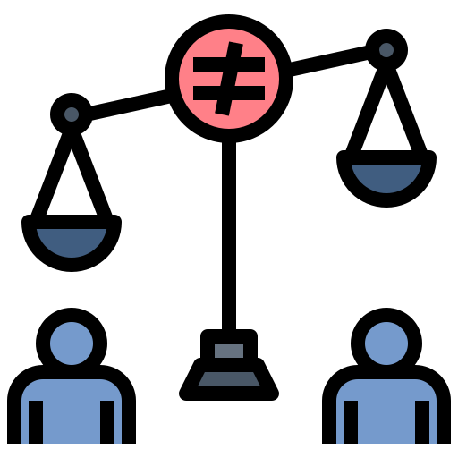

Legacy Sports Betting
Unfair
Uncertainty
Hidden Fees
Manipulate odds
Fake/Scam Platforms
Disputes of payout
Notes:
While this industry sees tremendous growth, there have been concerns raised of its fairness and transparency.
Firstly, they are unfair in that they often make profits either through hidden fees or by unfavorable odds, and profiting at the margins.
On top of that, there is uncertainty in that we cannot completely verify the authenticity of the platform, nor are bettors guaranteed a payout or dispute bets in a fair manner.

Slide 4






Our idea: BET5050
Immutability
Transparency
Stakeholder’s Incentive
Security
Accessibility
Anonymity
Compliance between all parties
Fairer odds
Prevent fraud/scams
Prevent malicious attacks
Available to everyone
No KYC
Notes:
Our Solution aims to resolve this problem with the use of smart contracts in our own dApp (Decentralized Application).
We believe that BET5050 has key advantages over legacy sports betting for the following reasons:
Immutability of the blockchain would allow for concrete betting practices where both the house and the user would have to comply with the results of a bet, and prevent either party from pulling out in case of an adverse bet outcome.
Next, smart contracts would ensure the transparency of all available bets online, such that no user is subjected to different odds compared to another user for the same bet. This will prevent hidden fees levied by the broker.
BET5050 also protects the host of the betting site as payouts will not be able to be reverted, protecting the house from fraudulent payments or betting accounts.
Having funds and bets stored on smart contracts make the application more resilient to malicious attacks.
Further, Unlike most legacy sports betting websites which have very limited availability to specific regions, our application will be readily accessible to everyone.
Finally, Users can remain anonymous and will not need to disclose any personal information or payment information besides a wallet address to participate.
Therefore, our application is a proposal of a betting contract on the blockchain, utilizing Oracles to source for off-chain data to settle bets.

Slide 5
02
DESIGN & FEATURES
Notes:
Next, we will move on to our application’s design and features

Slide 6
UML Diagram
Oracle
Bet5050
House
+ matches
+ matchIdToIndex
+ currentTime
+ Match
+ housePercentage
+ multFactor
- matchOracle
- matchOracleAddr
- minimumBet
+ bet
- betIdToBets
- userToBetIds
- userToMatchIds
- matchPaidOut
- userBetted
- matchIdToBetIds_winner
- matchIdToBetIds_firstScorer
- matchIdToBetIds_scoreline
+ _payOutWinnings(_user, _amount)
+ _transferToHouse()
- _isWinningBet(_status, _chosenWinner, _actualWinner)
- _calculatePayout(_winningTotal, _totalPot, _betAmount)
- _payoutForMatchWinner(_matchId, _status, _winner)
- _payOutForMatchFirstScorer(_matchId, _status, _firstScorer)
- _payOutForMatchScoreline(_matchId, _status, _scoreline)
+ checkOutcome(_matchId)
- _getMatchIndex(_matchId)
+ matchExists(_matchId)
+ addMatch(_matchName, _players, _startTime, _endTime)
+ setMatchUnderway(_matchId)
+ setMatchCancelled(_matchId)
+ declareOutcome(_matchId, _outcome, _winner, _firstScorer, _scoreline)
+ getPendingMatches()
+ getAllMatches()
+ getMatch(_matchId)
+ getMostRecentMatch(_pending)
+ testConnection()
+ getAddress()
+ addTest()
+ getOwner()
+ setCurrentTime(_yyyy, _mnth, _day, _hr, _min, 0, 0, 0)
+ getCurrentTime()
+ updateMatchStatus(_matchId)
+ setOracleAddress(_oracleAddress)
+ getOracleAddress()
+ _betIsValid(_user, _matchId, _betType, _betItem)
+ _teamValid(_matchId, betItem)
+ _playerValid(_matchId, betItem)
+ _scorelineValid(betItem)
+ _matchOpenForBetting(_matchId)
+ testOracleConnection()
+ getBettableMatches()
+ getAllMatches()
+ getMatch(_matchId)
+ getUserBets(_matchId)
+ getMostRecentMatch()
+ getUserBet(_matchId, _betType)
+ placeBet(_matchId, _betType, _betItem)
Notes:
Here, we showcase the main contract classes of our application.
The Oracle contract exists to provide pre-match information and post-match information to the Bet5050 contract.
Bet5050 settles all Ethereum related functions while the House contract (which Bet5050 inherits from) is responsible for all betting pool related functions.

Slide 7
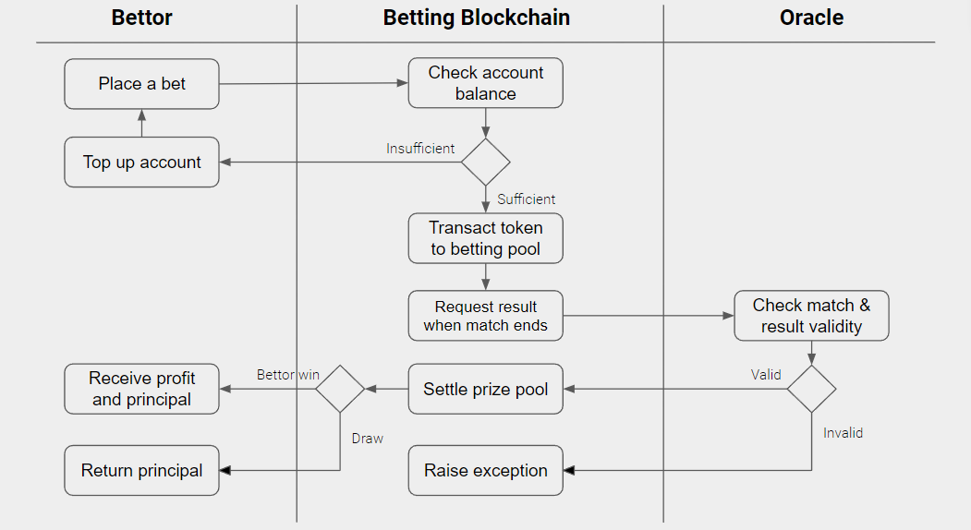
Betting Flow
Notes:
This diagram depicts the interactions between a bettor, our Bet5050 entity and Oracle entity.
As seen in the previous slide, the Bet5050 contract serves as the middleman by aggregating information (between the Bettors and Oracle) while the Oracle contract provides the Bet5050 blockchain with trusted information derived from the real world.

Slide 8


Features
Fair Odds
Variety
Amend Bets
Track Positions
Search Tools
Determined by free market
Myriad of Betting Types
Adjustable risk exposure
Awareness of present risk
Knowledge of matches
Notes:
These are the features that our team has targeted.
Users can expect odds which are determined by the free market, and not created by the house.
Next, users are able to track their positions, which fluctuates before a match commences. Hence, they will be able to be aware of their risk exposure.
There are also a variety of betting types that a bettor can bet on for a match, including the first scorer of the match, the winner of the match, and its final scoreline.
On top of that, users are given tools to review matches of interest, whether past, upcoming or most recent.
Finally, they are able to increase their risk exposure for a bet on the fly.
With these features, we hope that users are given a more competitive and favourable alternative than the status quo of legacy betting.

Slide 9
03
DEMO
Notes:
Now, I shall hand over the time to daize who will be showing us a demo of our application

Slide 10
THANKS!

